Slide 1
Dworshak FPOM Tour
March 8, 2017

Slide 2
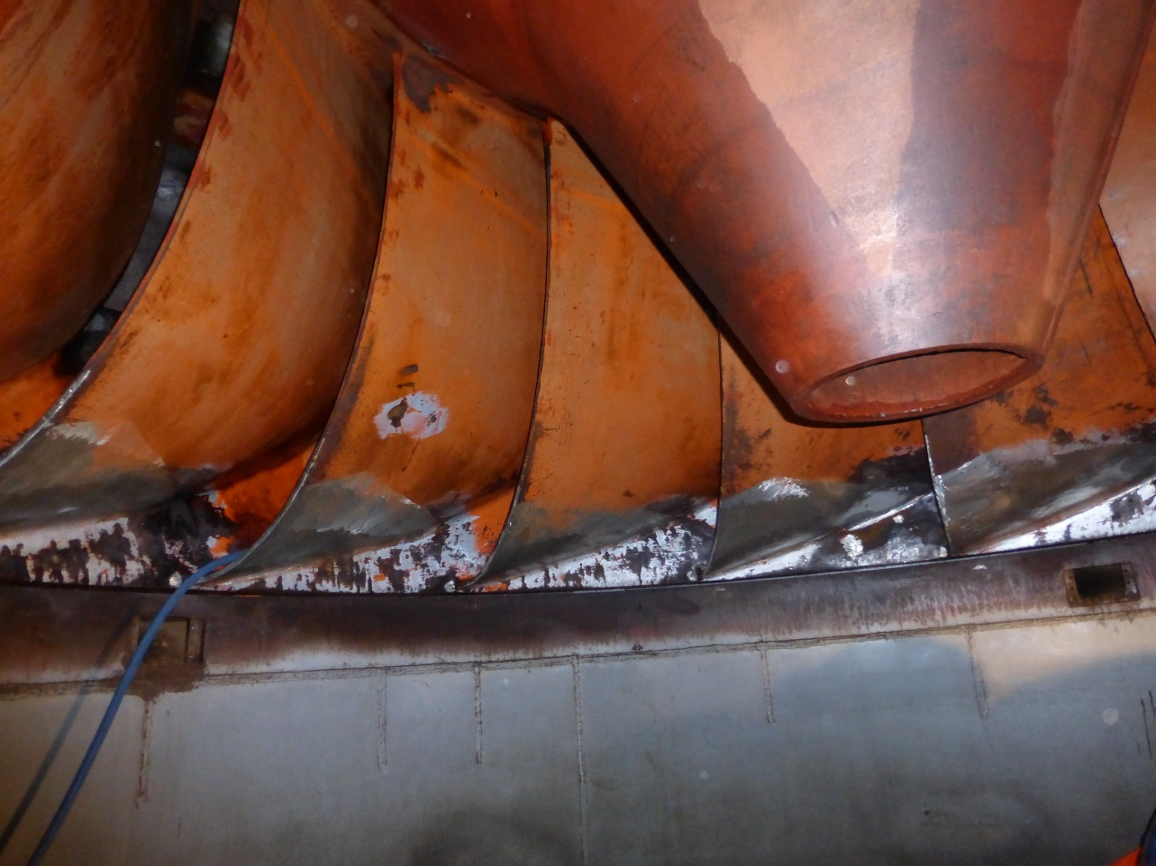
Runner and cone

Slide 3
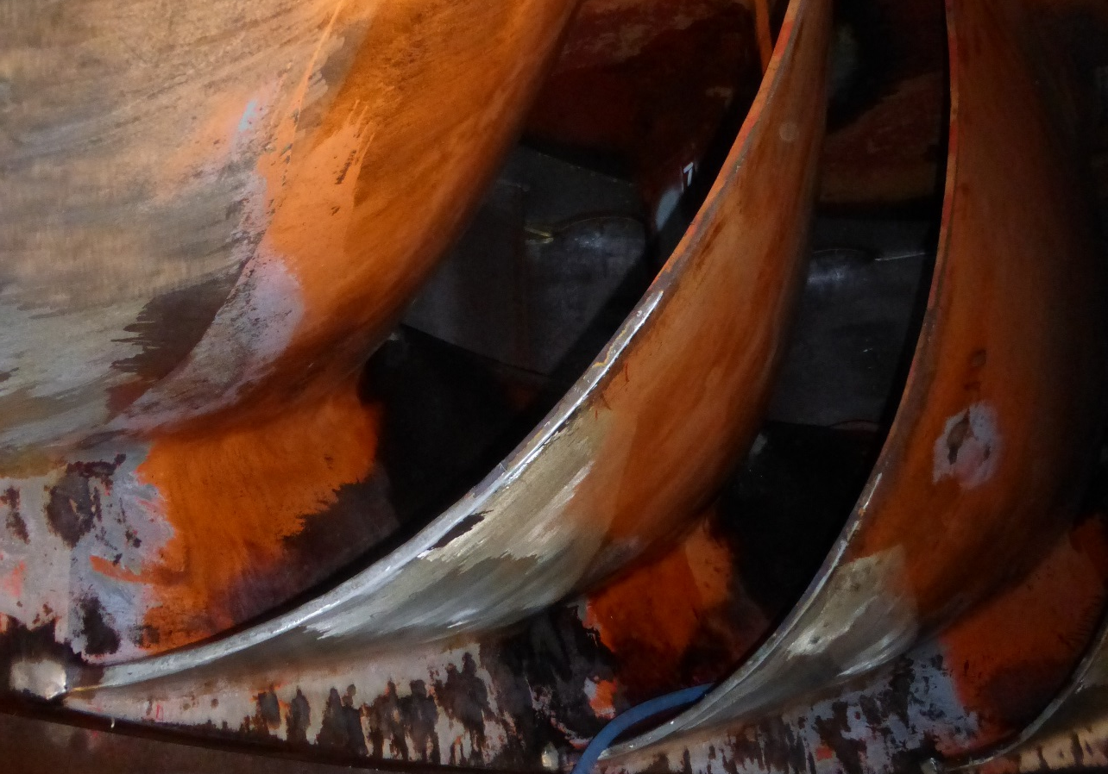
Turbine runner

Slide 4
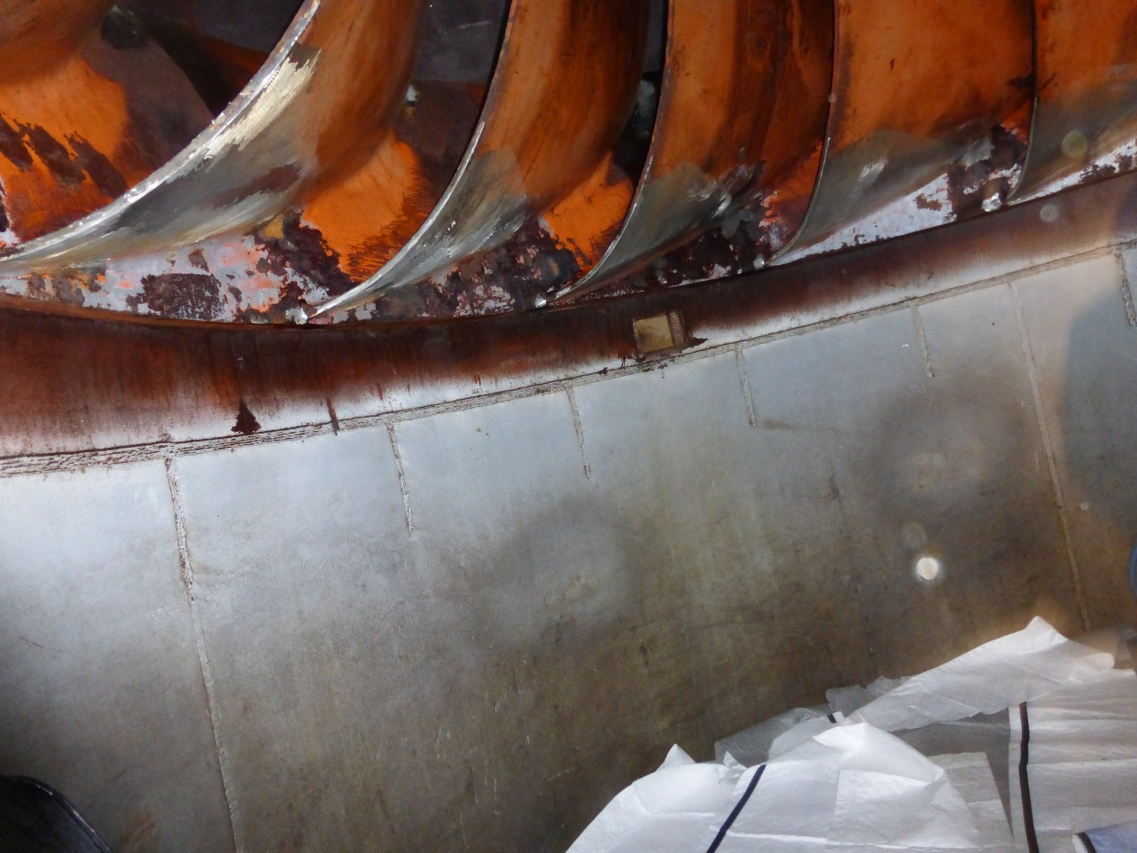
Turbine runner above, standing in start of draft tube

Slide 5
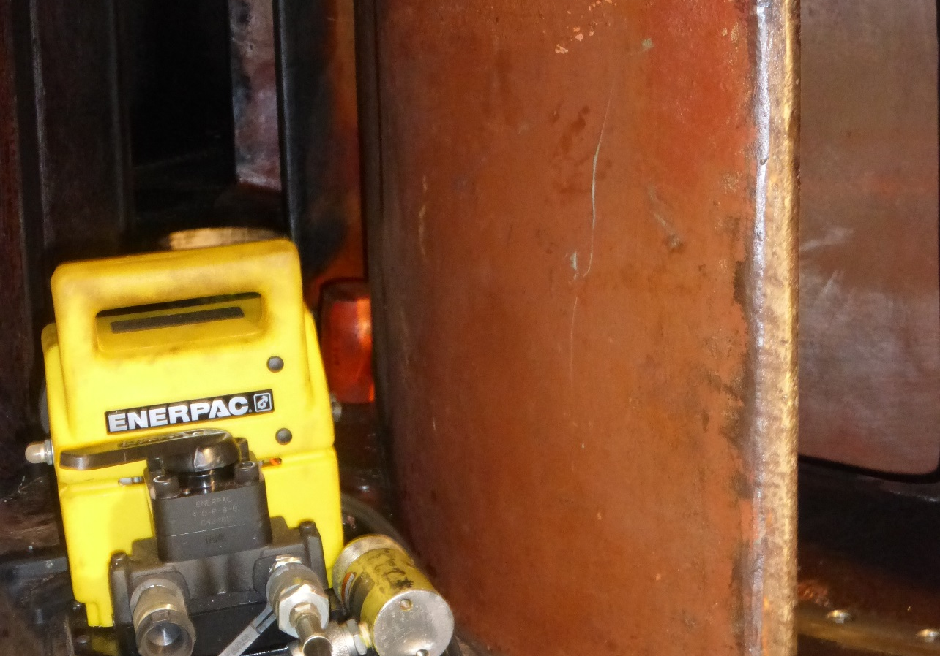
Wicket gate

Slide 6
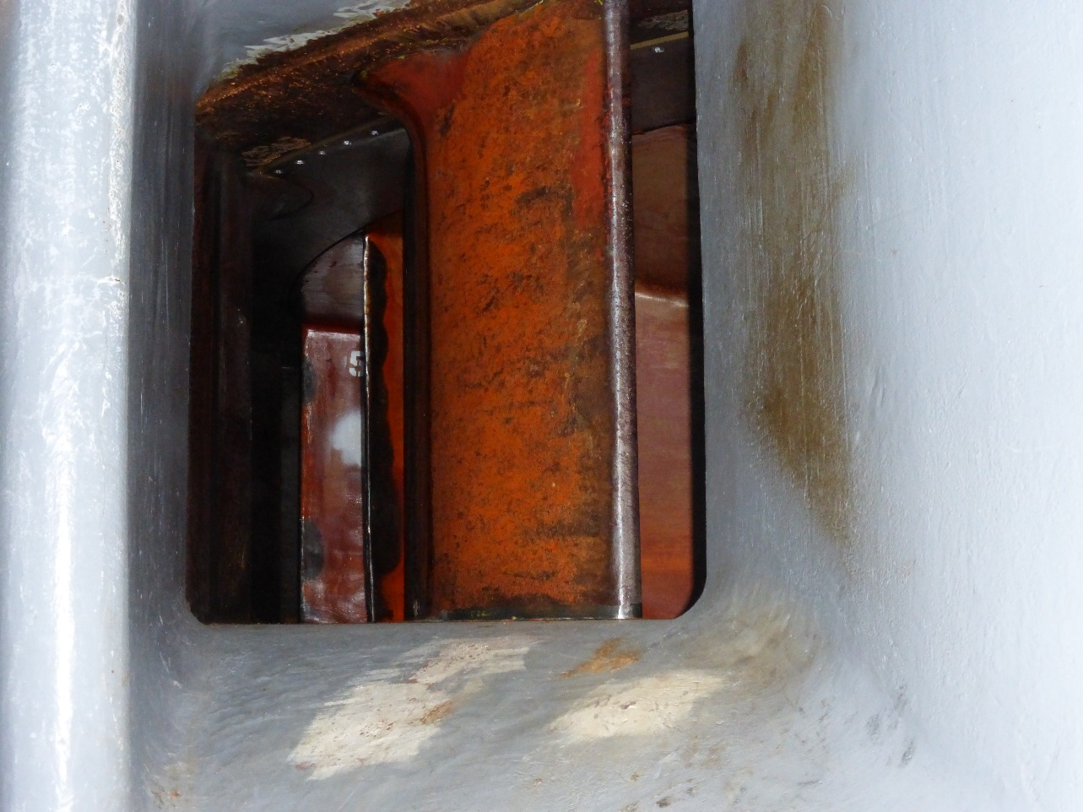
Looking through wicket gate to runner

Slide 7
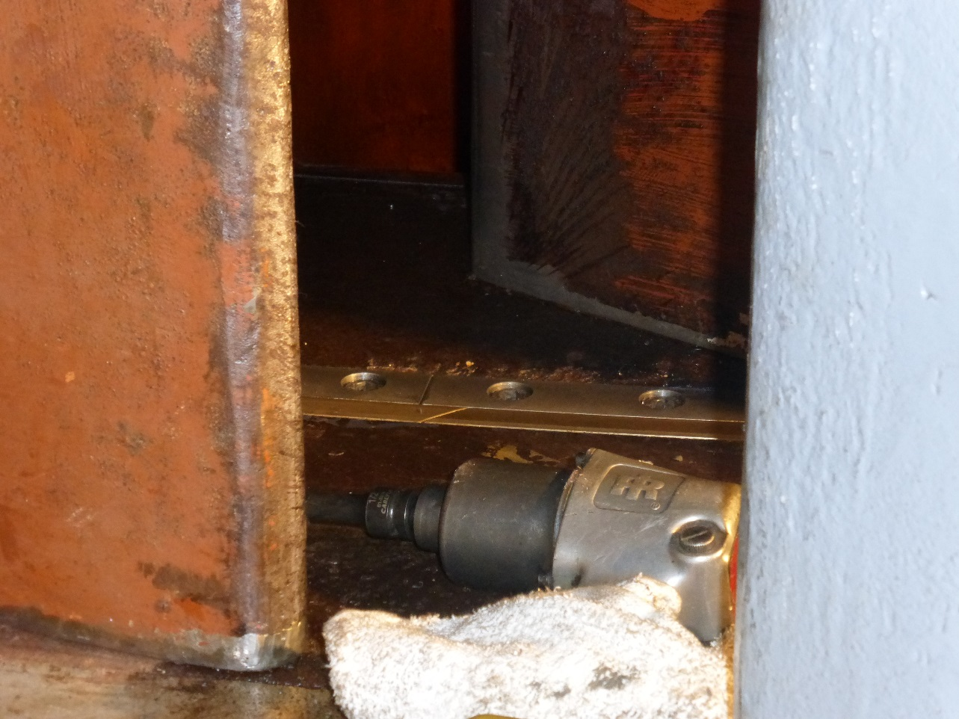
Wicket gate seal

Slide 8
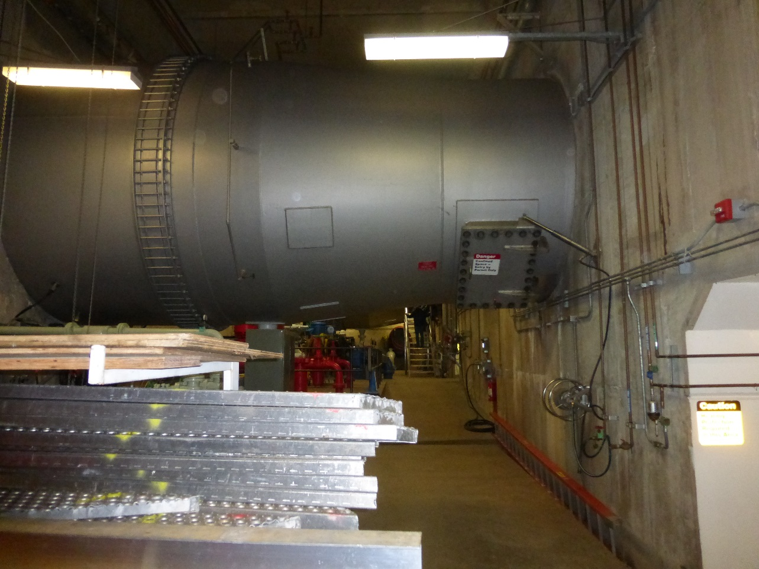
Intake conduit for unit

Slide 9
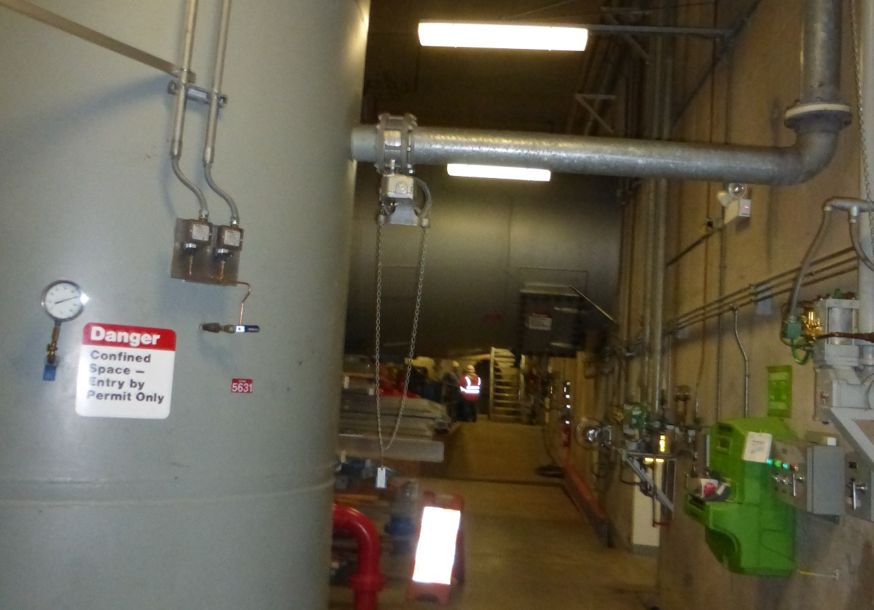
Oxygen depress system

Slide 10
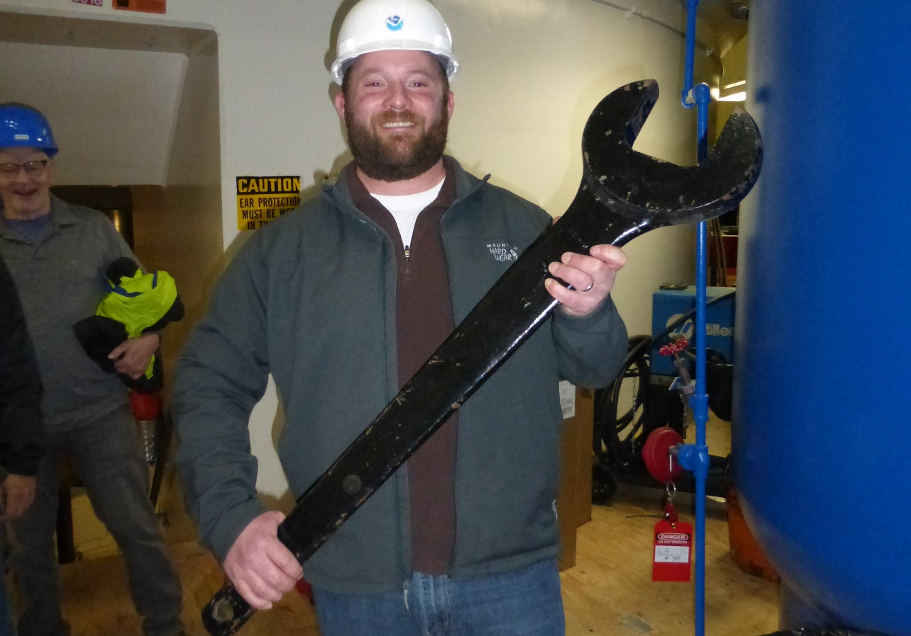
The big wrench

Slide 11
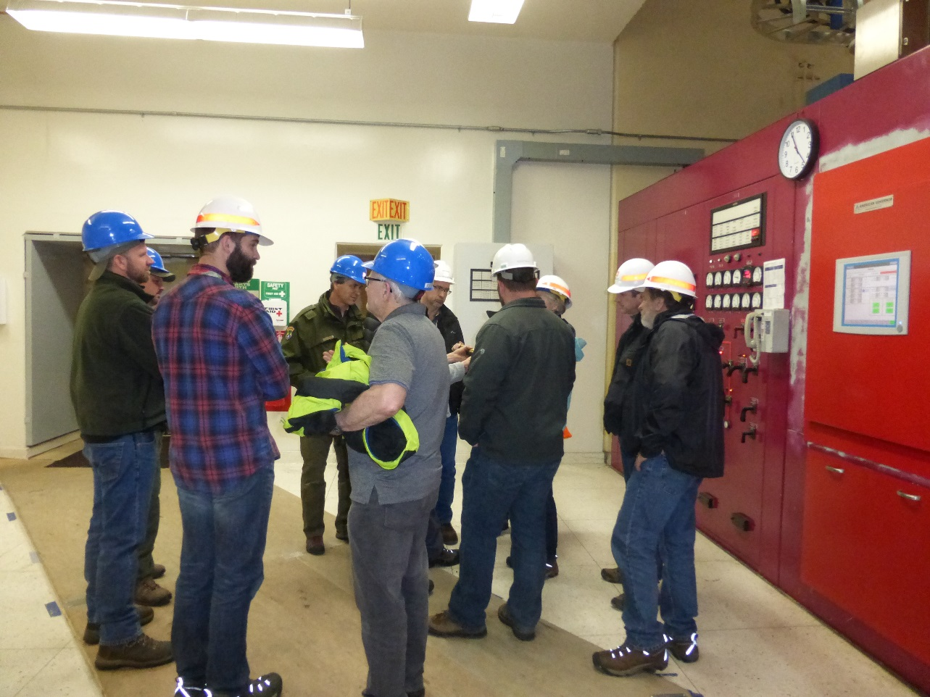
Manual operations control area

Slide 12
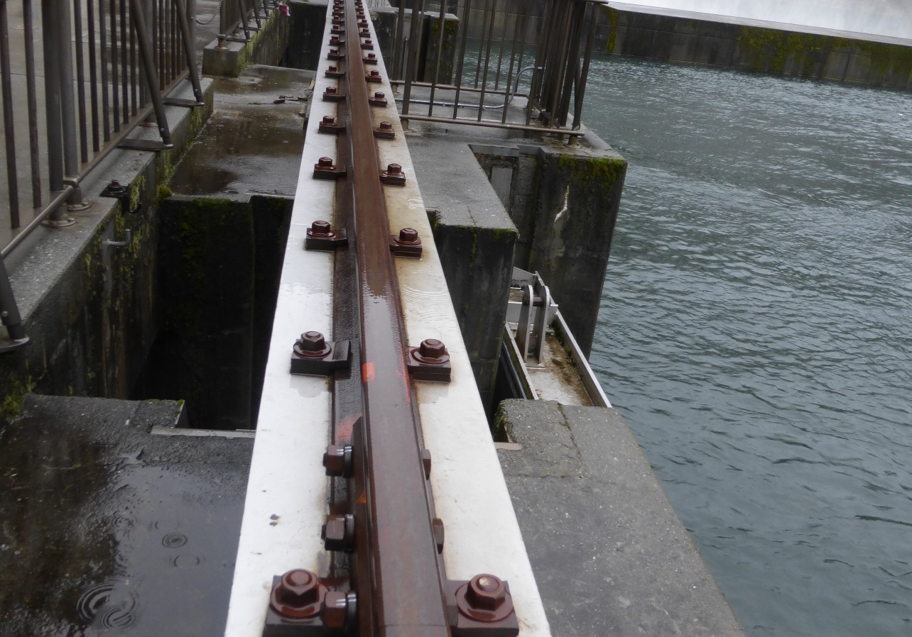
Crane rail limits access to slot area behind tail logs

Slide 13
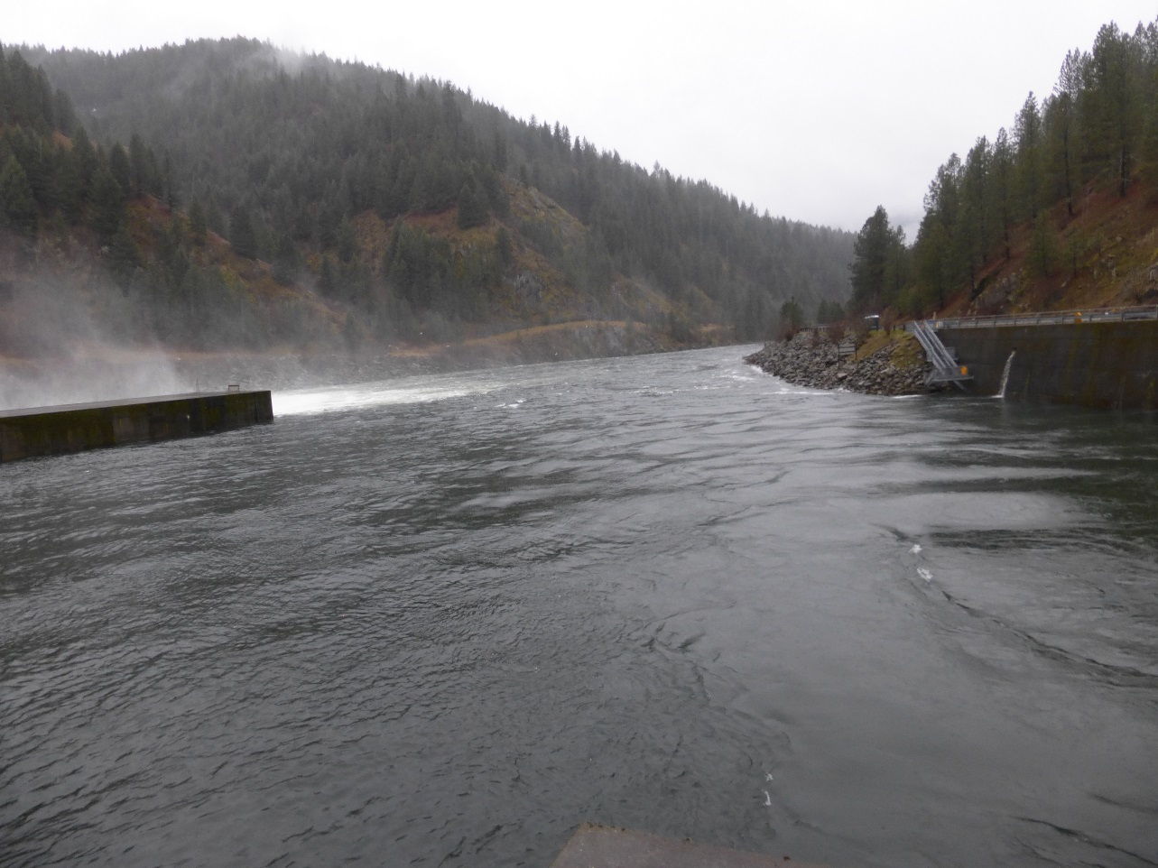
Tailrace with unit 1, 2 operating

Slide 14
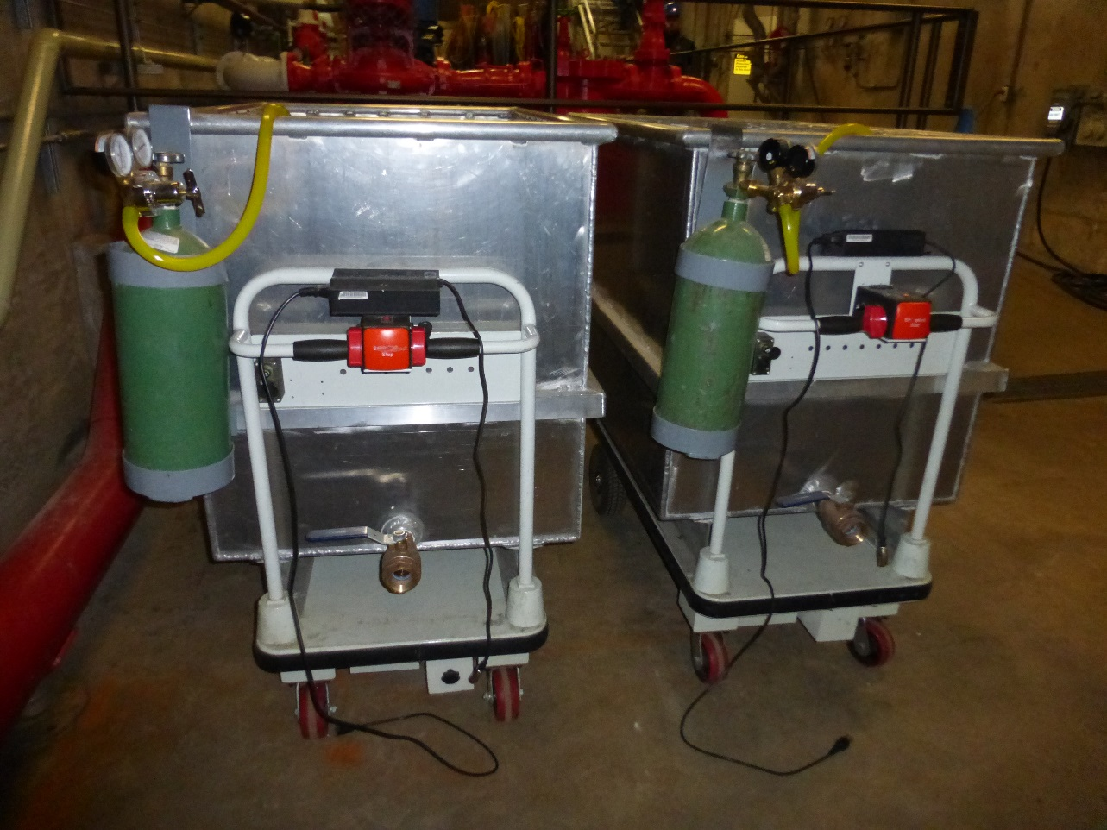
Tanks used for moving fish during unit salvage operations

Slide 15
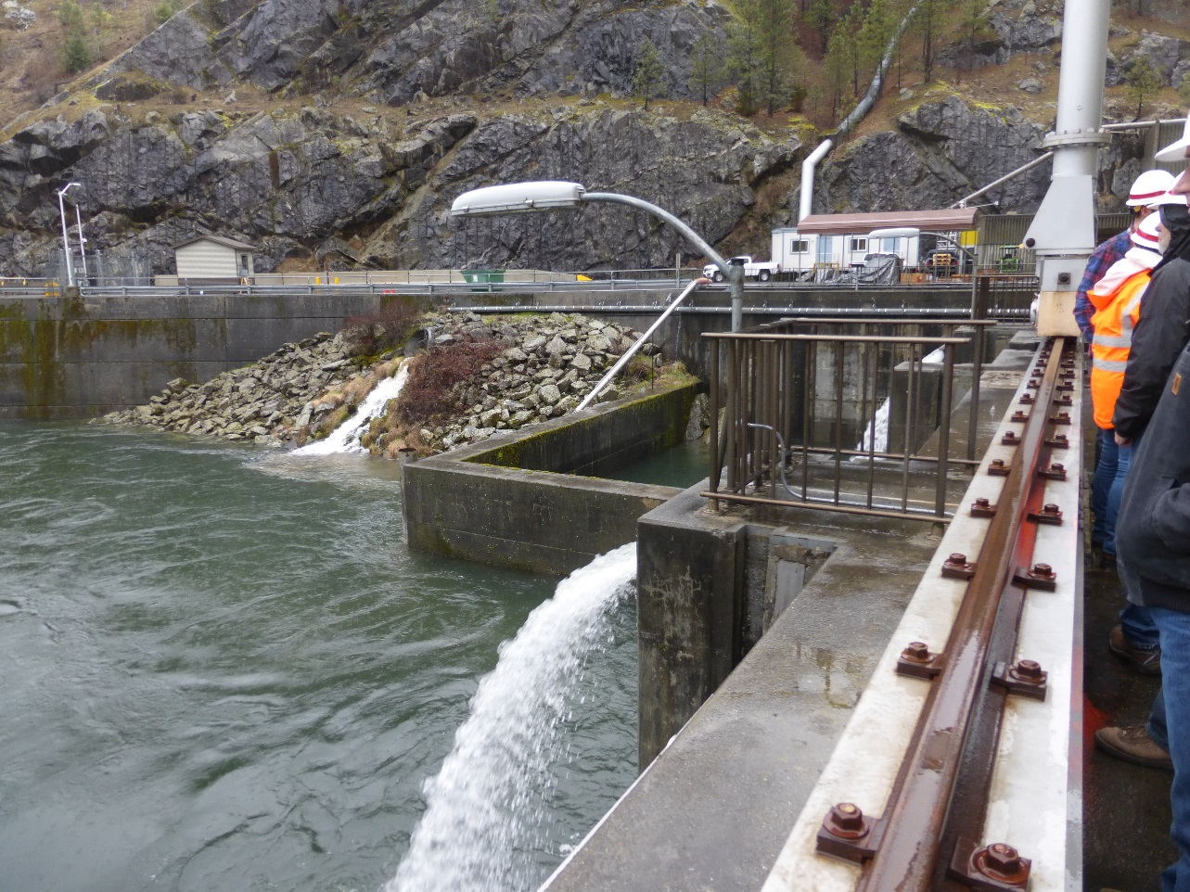
Fish release pipe hooks to tank and delivers fish to tailrace

Slide 16
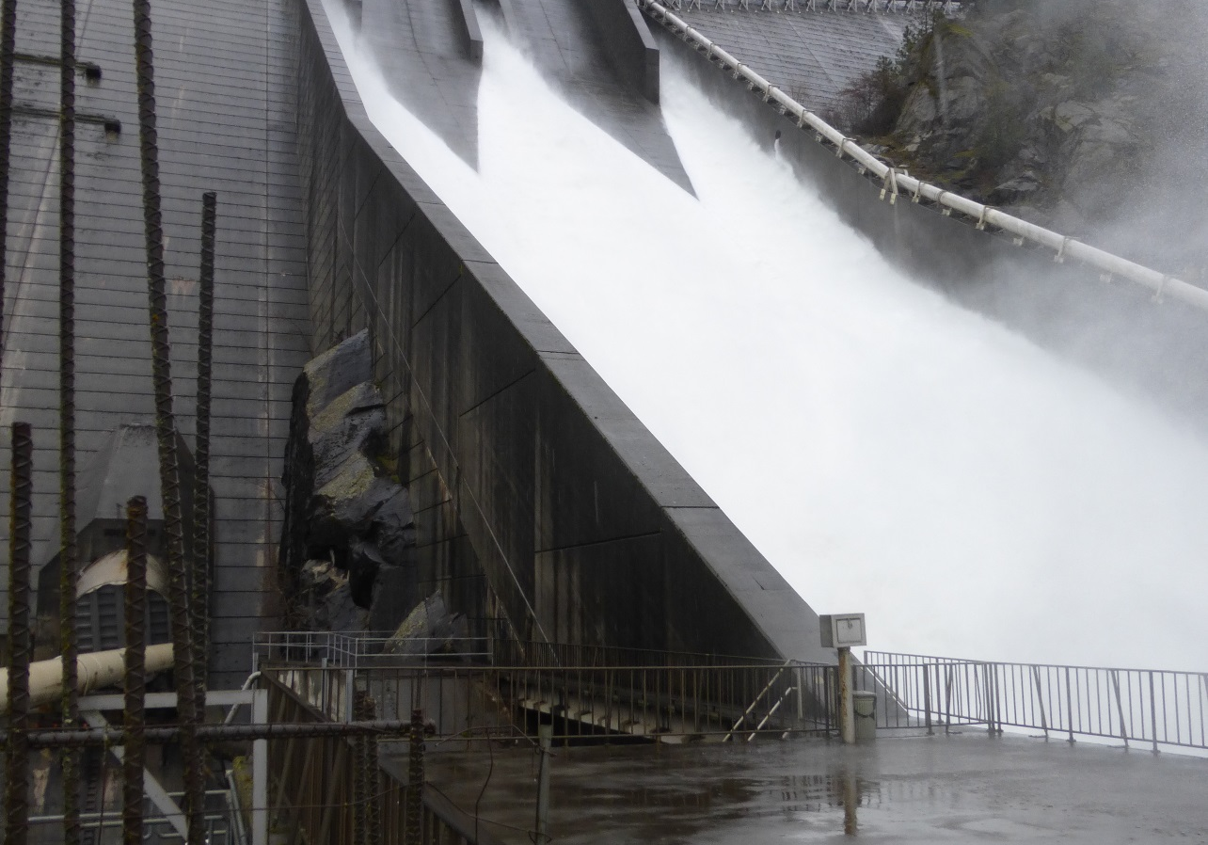
Spill through regulating outlets and pipeline for hatchery

Slide 17
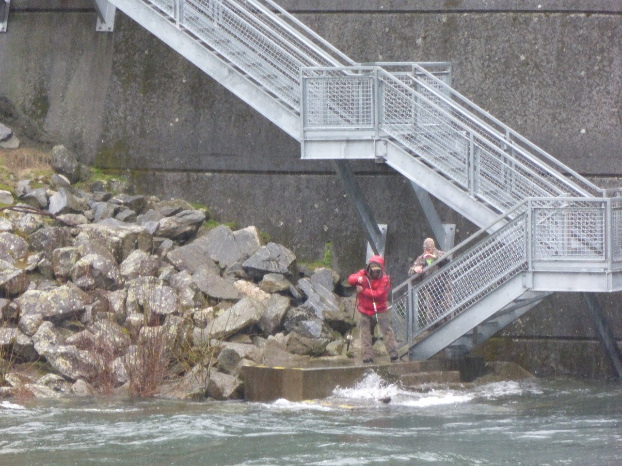
Angler hooks a steelhead along fishing wall below the dam

Slide 18
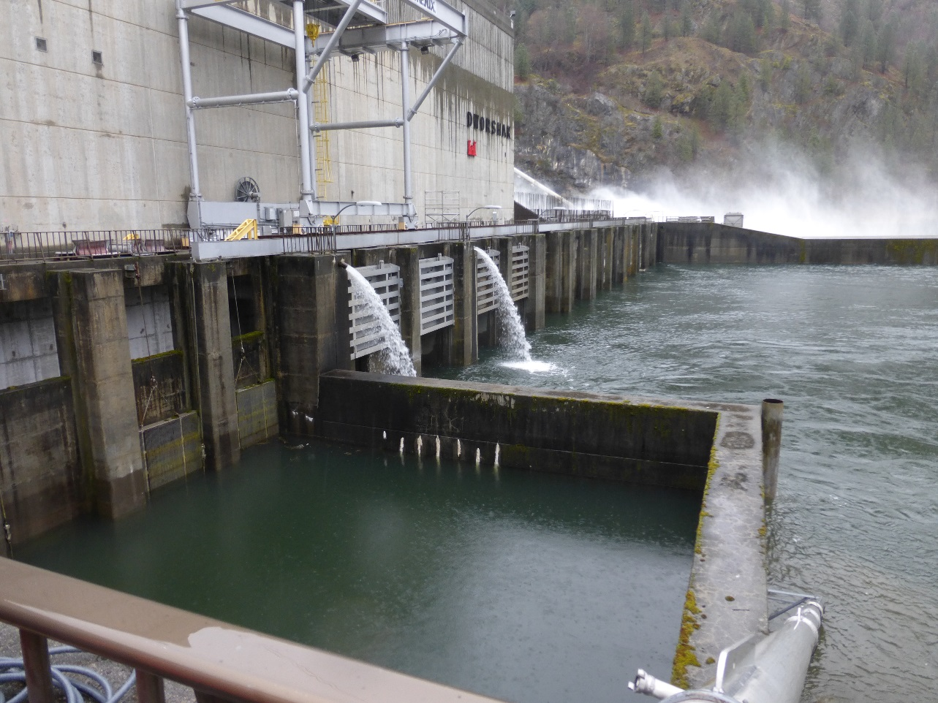
Tailrace area showing tail logs, crane

Slide 19
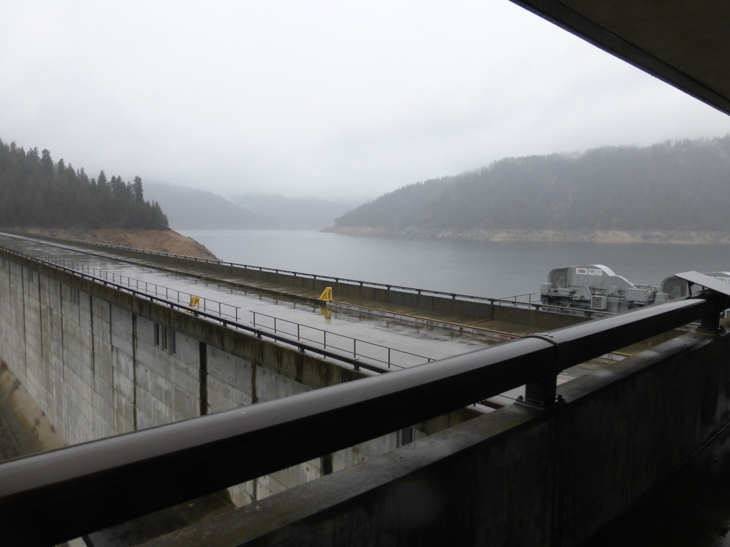
Forebay

Slide 20
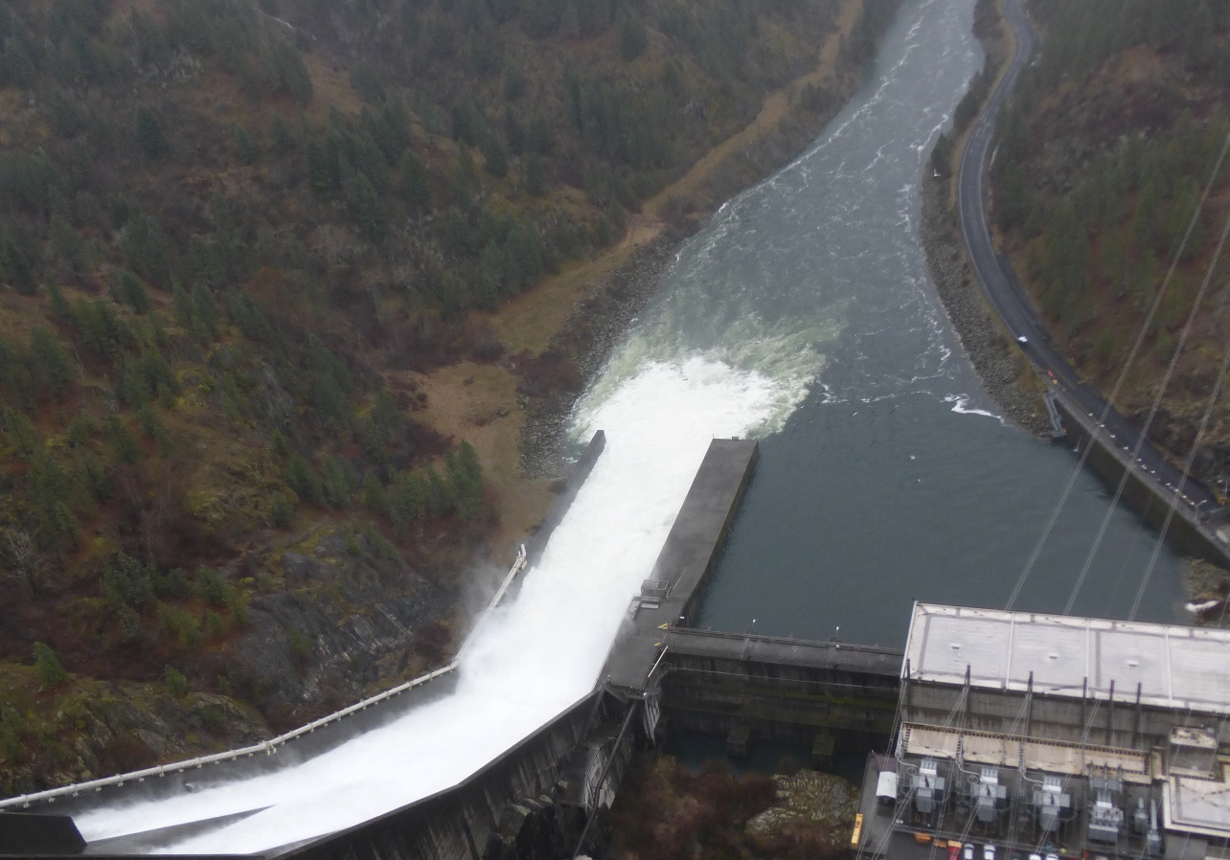
North Fork Clearwater from top of dam

Slide 21
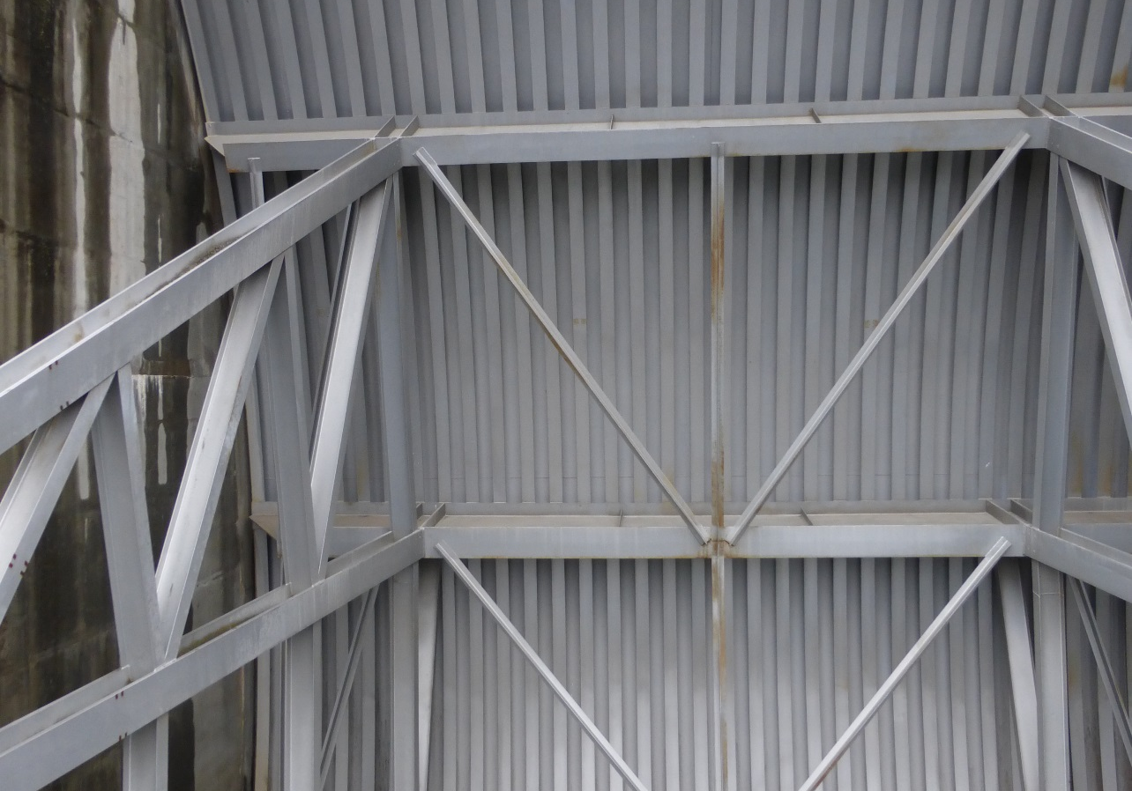
Spillgate

